Slide 1
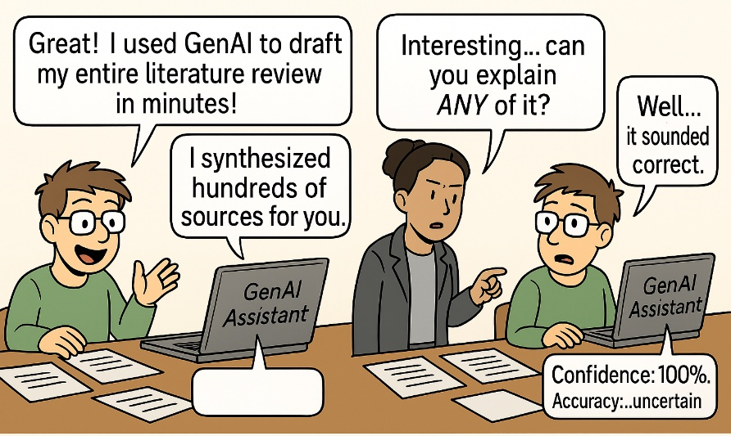
GenAI & Postgraduate Studies
Fionn O’Sullivan & Caitríona Ní Shé
Student Learning Development
& Trinity disAbility Service
www.tcd.ie/sld
student.learning@tcd.ie
Image generated by Microsoft Copilot
Notes:
What a mess of a picture – comment on this slop

Slide 2
Why should you be thinking about GenAI?
Already using it and want guidance on Trinity policy
Impact on learning & skill development
Academic integrity & ethical concerns

Slide 3
TCD Policy
The use of Generative AI is permitted unless otherwise stated in course handbooks – BUT you must acknowledge its use.
‘Correctly document your use of the tools so that it can be appropriately acknowledged.’
‘Retain drafts of your work so you can evidence your process.’
‘Where a student or researcher is required to use a standard referencing style which has specific rules for citing and referencing GenAI, the rules of the citation style should be followed, in addition to acknowledging the use of GenAI as outlined below.’
‘The use of GenAI must be acknowledged in an ‘Appendix’ or 'Methods' section of any piece of academic work where it has been used as a functional tool to assist in the process of creating academic work.’

Slide 4
Library Guide for Referencing GenAI
Minimum requirements to include in acknowledgement:
Name and version of the GenAI system used; e.g. Microsoft Copilot (version GPT-4)
Publisher (company that made the |GenAI system); e.g. Microsoft; Anthropic, OpenAI
URL of the GenAI company.
Brief description (single sentence) of context in which the tool was used.
For example:
I acknowledge the use of Microsoft Copilot (version GPT-4, Microsoft, https://copilot.microsoft.com) to summarise my initial notes and to proofread my final draft.’
See TCD Library Guide: https://libguides.tcd.ie/gen-ai/introduction

Slide 5
Data Privacy: What can you NOT do with GenAI?
Some uses are illegal due to breaking GDPR law
‘You are NOT allowed to use private student or staff information as part of your queries or instructions when using GenAI tools.’
‘Content which is confidential in Trinity, confidential to your studies or work (research, teaching or administrative), which is not public or for which you do not own the copyright should NOT be used in creating prompts or providing context information for GenAI to generate content.’
FROM Centre for Academic Practice, Trinity Teaching & Learning - Trinity College Dublin (tcd.ie)
Notes:
One thing is clear – data privacy context
Example: interviews/data as part of dissertation

Slide 6
For Thesis/Papers: Check your School/Department Handbook
Different disciplines within the college have different rules
Questions you can ask your school/department:
  Can you use it?
  Can you use it for some things and not others (i.e. for research prompts but not for generating content)?
  When you cite it, what information should you include in addition to Library guidance (i.e. prompts inputted, responses received, etc)?

Slide 7
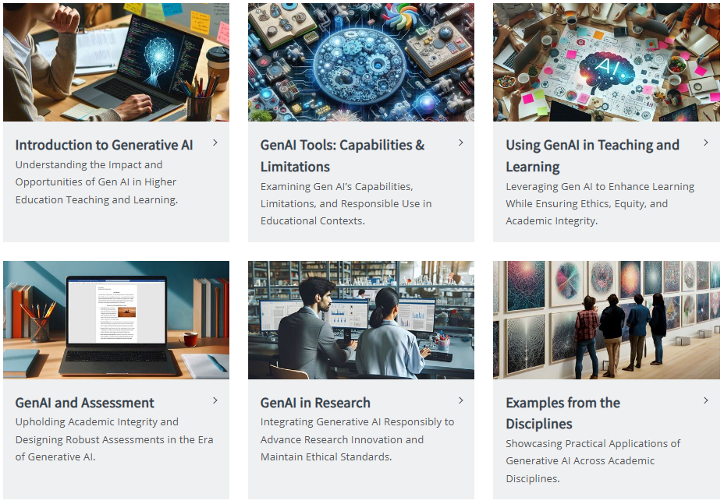
GenAI Hub
TCD GenAI Hub: https://www.tcd.ie/academicpractice/resources/generative_ai/
Notes:
A lot of this is aimed more at teaching staff and lecturers. However, it gives you a good overview of TCD’s policy on GenAI, particularly with regards to research

Slide 8
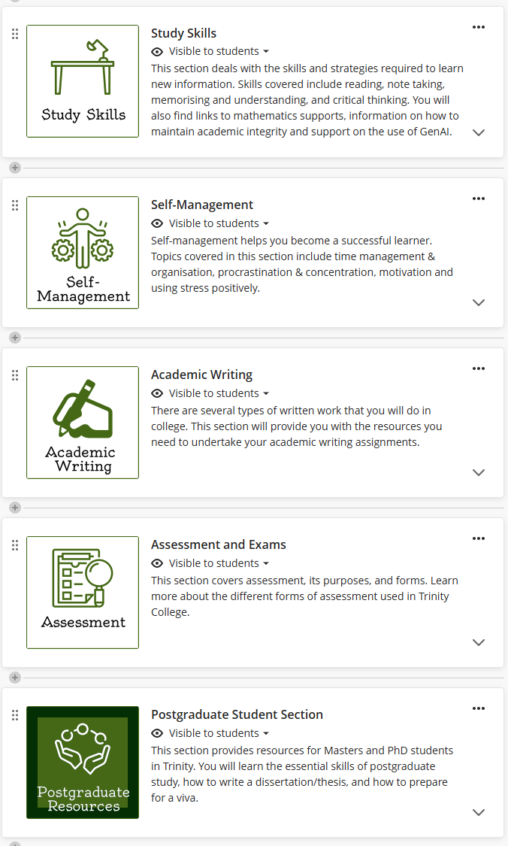
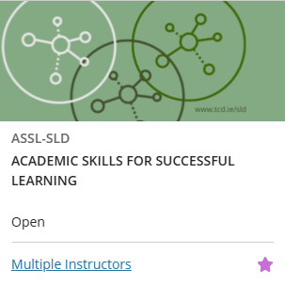
SLD Blackboard Resources
Log into Blackboard.
Click Modules in the left menu.
Click Module Catalogue in the top right corner.
Search for ‘Academic’.
Find the ‘ASSL-SLD’ module. Click on and ‘Enroll’.

Slide 9
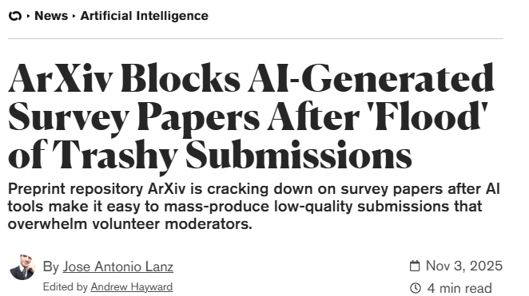
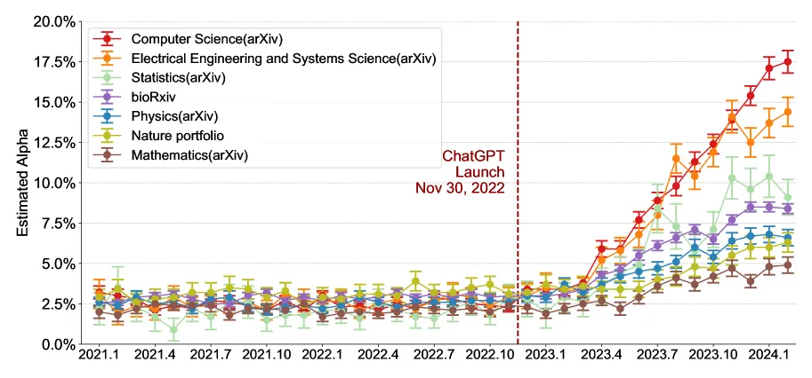
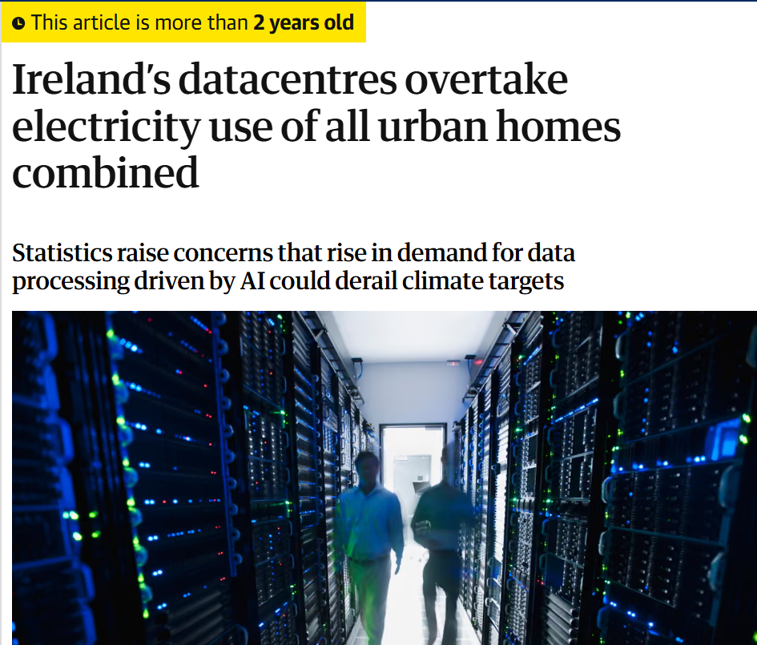
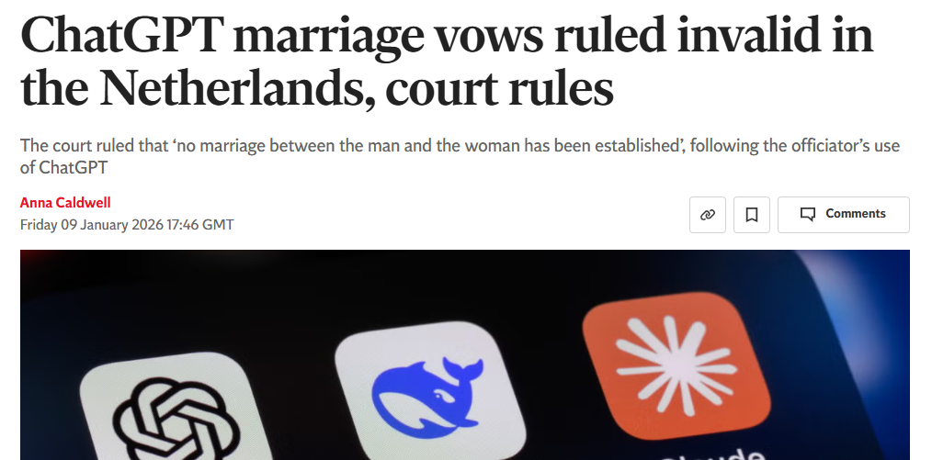
Liang et al. (2024)

Slide 10
What is at stake when we use GenAI?
What do we risk as students?
  Cognitive atrophy through repeated cognitive offloading
What do we risk as individuals?
  Trust in our own creativity and abilities
What do we risk as researchers?
  Close understanding of our own data/materials
What do we risk as professionals?
  Responsibilities one has towards e.g. patients, clients
What do we risk as societies?
  Standards of quality (Search engines and Wikipedia suddenly seem palettable)
  Taking about software using personifying language risks virtualising real people
Notes:
Are the answers correct? Any mistakes? Overly general? Bias towards certain material or narratives?

Slide 11
Wider GenAI threats
Academic GenAI concerns
Disinformation
Energy use & climate targets (Data centres were 21% of Ireland’s electricity grid in 2024)
Appropriation of content produced by humans
Exploitative data acquisition (destroying books) and training (data labour)
Reproducing bias and discrimination
New access divides (who has access to what AI models)
Cybersecurity/lack of “guardrails”
‘Hallucinations’ e.g. incorrect references/citations
No access to paywalled articles (over-represents lower-quality information)
Text can be generic and lacking originality
Academic misconduct penalties
Overreliance ->Underdevelopment of research skills:
  Critical thinking
  Formulating original opinions
  Expression
  Synthesising
Notes:
generative AI has, as described above, the potential to replace workers of all kinds, including so-called “knowledge workers” [12]. Even if humans are not replaced by AI, there is a risk that work changes, and whenever this occurs we need to be wary of how power constellations change and whether such changes are conducive to the decency of work … Generative AI will likely have a major impact on both economic growth (SDG 8) and innovation (SDG 9), and it will consequently be important to ensure that this impact is positive and conducive to socially sustainable development. It is, however, also important to note that while developing generative AI models is in theory possible for all, it requires vast resources, and a world increasingly using such models risks being increasingly dependent on large tech companies
Power: 8 sec clip – running a microwave for an hour
Stealing content: first in open violation of copyright, now through corporate agreements
Premium vs free versions

Slide 12
GenAI & learning: What to delegate, what to not?
Take a moment to consider the different tasks involved in academic work/your learning process. How do you think you might best support yourself in this?
what about...?​
Asking for resources/summary on a new topic​
Validating/confirming something is true/not​
Assessing your knowledge of something​
Prioritising tasks​
Generating essay plans​
Reviewing work

Slide 13
ROCKS framework
4D framework
Role: Identify your role.
Objective: State your objective.
Community: Specify your audience
Key: Describe the tone or style, and any related parameters.
Shape: Note the desired format of the output.
Source: → Think before you prompt: Reduce your AI carbon footprint with ROCKS : #ALTC Blog
Delegation: Set goals. Decide whether, when and how to engage. What tasks should you do? What can be given to AI?
Description: Effectively describing goals to prompt useful Al behaviors and outputs.
Discernment: Accurately assess the usefulness of Al outputs in context.
Diligence: Take responsibility for what you do we do it. Use AI disclaimers.
Source: AI Fluency: Framework & Foundations – Open Courses
Notes:
AI is not intended to be a one-stop shop. Do thinking before you submit a prompt. This framework can help.
Optional, if time allows: Take a moment to identify a task that you think could be outsourced to AI and prepare a plan for implementing it based on the 4D framework

Slide 14
Strengths/Opportunities
Summarising large volumes of information *
Identifying key points *
Explaining terminology/theories *
Avoiding procrastination
Avoiding reading irrelevant material
Ironing out grammatical errors
Rewording language/refining syntax.
Be used as a ‘jumping off’/mind mapping tool
*Results vary
Notes:
Summarising large volumes of information/long research papers/articles.
Identifying key points in texts.
Avoiding procrastination – you can ask prompts around your research/topic area as a ‘jumping off point’, and then follow this up with your own critical thinking and analysis.
Explaining terminology/theories that you don’t understand.
Ironing out grammatical errors.
Rewording language and refining syntax for clarity.

Slide 15

Skills SLD can support you in developing
Reading
Note-taking
Critical thinking
Academic writing
Structuring
Revising
student.learning@tcd.ie

Slide 16

Questions
Engage in debate!
Keep an eye on emails for Student Forums on GenAI and opportunities to be part of Trinity's research

Slide 17
What is Generative AI?
New term for older tech: training programs to generate patterns
For LLMs: data typically taken from the internet, often in violation of copyright
  Human workers then refine the responses
Data is stored on company servers to train their future products
Outputs are generated by prediction of patterns, not consulting a database
Notes:
AI as a subset of GenAI. I will use those two interchangeably today, but I mean GenAI. Chatbots like ChatGPT, Gemini, Claude, etc.
Simplification: like text prediction when you type. Essentially a next-word predictor
Text is broken down into tokens
Large language models, looking at patterns, arrange tokens into matrices, looking at proximity across large corpuses of text
LLMs don’t have access to all of that text, however: they have what is known as the “context window”

Slide 18
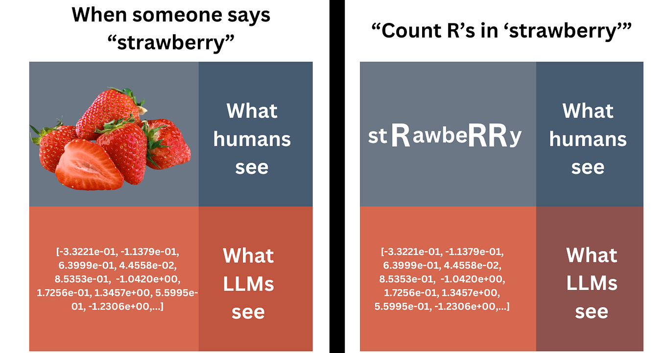
What is Generative AI?
Notes:
AI as a subset of GenAI. I will use those two interchangeably today, but I mean GenAI. Chatbots like ChatGPT, Gemini, Claude, etc.
Simplification: like text prediction when you type. Essentially a next-word predictor
Text is broken down into tokens
Large language models, looking at patterns, arrange tokens into matrices, looking at proximity across large corpuses of text
LLMs don’t have access to all of that text, however: they have what is known as the “context window”

